Slide 1
宏观经济学
中央财经大学2019年春季学期
第II篇：经济周期理论与中国经济波动
陈斌开

Slide 2

经济周期：为何如此重要？

Slide 3
经济周期的主要问题
为什么就业和工资会波动？
为什么产出会波动？
为什么价格有波动？
是否可能熨平经济周期？

Slide 4
经济增长与经济周期
经济增长：长期
经济周期：短期
趋势与波动
潜在产出与真实产出

Slide 5
本篇主要内容
第四讲：经济周期的古典思考（M:3章）
第五讲：凯恩斯经济周期理论：总需求理论 （M: 10 &11章）
第六讲：总供给与总需求——经济波动理论 基本分析框架（M: 9章）
第七讲：理解中国经济周期

Slide 6
第4讲、经济周期理论的古典思考：基于国民收入的分析

Slide 7
本讲内容
经济中的总供给：总产出的决定
总供给：要素市场和国民收入的分配
经济中的总需求：产品与服务需求的决定
市场均衡
slide <number>

Slide 8
模型概述
一个封闭经济、市场出清的模型
供给方
  要素市场 (供给，需求，价格)
  产出或收入的决定
需求方
  C、I 和 G 的决定因素
均衡
  产品市场
  可贷资金市场
slide <number>
Notes:
It’s useful for students to keep in mind the “big picture” as they learn the individual components of the model in the following slides.

Slide 9
一、总供给：生产函数
表达式为：Y = F (K, L)
含义：经济体从K 单位的资本和L 单位的劳动中可得到多少单位的产出Y 。
意义：反映了经济体的技术水平。
特征：规模收益保持不变。
slide <number>

Slide 10
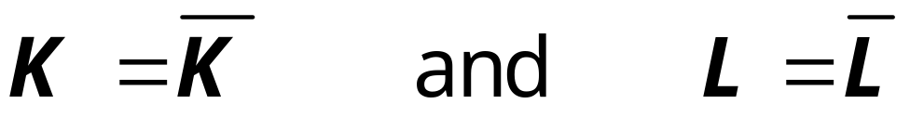
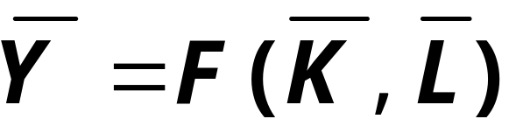
模型的假设
短期内：
技术保持不变；
经济体中的资本和劳务的供给量固定在下列水平上：
产出由固定要素的供给和不变技术所决定：
slide <number>
Notes:
Emphasize that “K” and “L” (without bars on top) are variables-- they can take on various magnitudes. On the other hand, “Kbar” and “Lbar” are specific values of these variables. Hence, “K = Kbar” means that the variable K equals the specific amount Kbar.
Regarding the assumptions:
In Chapters 7 and 8 (Economic Growth I and II), we will relax these assumptions: K and L will grow in response to investment and population growth, respectively, and the level of technology will increase over time.

Slide 11
二、国民收入的分配
国民收入通过要素价格进行分配（要素价格是对于每单位产出，厂商支付给要素所有者的价格）。
工资是劳动的价格，租金率是资本的价格。
slide <number>
Notes:
Recall from Chapter 2: the value of output equals the value of income. The income is paid to the workers, capital owners, land owners, and so forth. We now explore a simple theory of income distribution.

Slide 12
符号说明
W = 名义工资
R = 名义租金率
P = 产出的价格
W /P = 实际工资
(用产出的单位数来衡量)
R /P = 实际租金率
slide <number>
Notes:
It might be worthwhile to refresh students’ memory about nominal and real variables.
The nominal wage & rental rate are measured in currency units.
The real wage is measured in units of output.
To see this, suppose W = $10/hour and P = $2 per unit of output.
Then, W/P = ($10/hour) / ($2/unit of output) = 5 units of output per hour of work.
It’s true, the firm is paying the workers in money units, not in units of output. But, the real wage is the purchasing power of the wage-- the amount of stuff that workers can buy with their wage.

Slide 13
要素价格的决定
要素价格由要素市场的供给和需求来决定。
回忆：每项要素的供给是固定不变的。
那么需求如何？
slide <number>
Notes:
Since the distribution of income depends on factor prices, we need to see how facto prices are determined.
Each factor’s price is determined by supply and demand in a market for that factor. For instance, supply and demand for labor determine the wage.

Slide 14
对劳动的需求
假设市场是竞争的：
每家厂商将W、R和P 视为既定的变量。
基本思想：
如果相关成本不超过收益，那么厂商雇佣一个单位的劳动。
  成本 = 实际工资
  收益 = 劳动的边际产量
slide <number>

Slide 15
劳动的边际产量(MPL)
定义:
厂商通过追加的劳动（同时保持其他投入不变）所能够获得的产量：
MPL = F (K, L +1) – F (K, L)
slide <number>

Slide 16

劳动的边际产量与生产函数
Y
产出
（output）
MPL
1
当更多的劳动付出时，MPL ↓
MPL
1
生产函数的斜率等于MPL
MPL
1
L
劳动（labor）
slide <number>
Notes:
(Figure 3-3 on p.49)
To the instructor:
It’s straightforward to see that the MPL = the prod function’s slope:
The definition of the slope of a curve is the amount the curve rises when you move one unit to the right. On this graph, moving one unit to the right simply means using one additional unit of labor. The amount the curve rises is the amount by which output increases: the MPL.

Slide 17
边际收益递减
当要素投入增加（其他条件保持不变）时，其边际产量下降。
直观理解：
当L ↑ 时保持K不变
  ⇒ 每个工人将拥有更少的机器设备
  ⇒ 更低的生产率
slide <number>
Notes:
Tell class: Many production functions have this property.
This slide introduces some short-hand notation that will appear throughout the PowerPoint presentations of the remaining chapters:
The up and down arrows mean increase and decrease, respectively.
The symbol “⇒” means “causes” or “leads to.”
Hence, the text after “Intuition” should be read as follows:
“An increase in labor while holding capital fixed causes there to be fewer machines per worker, which causes lower productivity.”
Many instructors use this type of short-hand (or something very similar), and it’s much easier and quicker for students to write down in their notes.

Slide 18
MPL 与劳动需求
产出数量
Units of output
每家厂商增加雇佣劳动，直到MPL = W/P为止。
实际工资
MPL, 劳动需求
劳动数量
Units of labor, L
劳动需求量
slide <number>
Notes:
It’s easy to see that the MPL curve is the firm’s L demand curve.
Let L* be the value of L such that MPL = W/P.
Suppose L < L*. Then, benefit of hiring one more worker (MPL) exceeds cost (W/P), so firm can increase profits by hiring one more worker.
Instead, suppose L > L*. Then, the benefit of the last worker hired (MPL) is less than the cost (W/P), so firm should reduce labor to increase its profits.
When L = L*, then firm cannot increase its profits either by raising or lowering L.
Hence, firm hires L to the point where MPL = W/P.
This establishes that the MPL curve is the firm’s labor demand curve.

Slide 19

均衡的实际工资
产出数量
Units of output
劳动供给
均衡的实际工资W/P
MPL, 劳动需求
劳动数量（Units of labor, L）
实际工资调整至劳动供求相等点。
slide <number>
Notes:
The labor supply curve is vertical: We are assuming that the economy has a fixed quantity of labor, Lbar, regardless of whether the real wage is high or low.
Combining this labor supply curve with the demand curve we’ve developed in previous slides shows how the real wage is determined.

Slide 20
租金率递减
我们已知： MPL = W/P
同理，我们可得：MPK = R/P :
资本收益递减： K ↑ ⇒ MPK ↓
资本的边际产量（MPK）曲线是厂商对租用资本的需求。
厂商通过选择MPK = R/P 使得利润最大化。
slide <number>
Notes:
In our model, it’s easiest to think of firms renting capital from households (the owners of all factors of production). R/P is the real cost of renting a unit of K for one period of time. In the real world, of course, many firms own some of their capital. But, for such a firm, the market rental rate is the opportunity cost of using its own capital instead of renting it to another firm. Hence, R/P is the relevant “price” in firms’ capital demand decisions, whether firms own their capital or rent it.

Slide 21

均衡的实际租金率
产出数量
Units of output
资本的供给
实际资金率将调整至资本供求相等点。
均衡的实际租金率R/P
MPK, 资本的需求
资本数量 Units of capital, K
slide <number>
Notes:
The previous slide used the same logic behind the labor demand curve to assert that the capital demand curve is the same as the downward-sloping MPK curve.
The supply of capital is fixed (by assumption), so the supply curve is vertical.
The real rental rate (R/P) is determined by the intersection of the two curves.

Slide 22
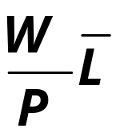

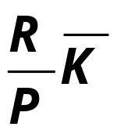

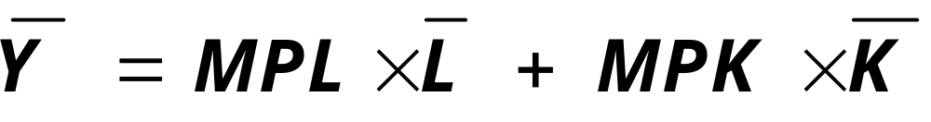
收入是如何分配的:
全部劳动收入 =
全部资本收入 =
如果生产函数规模收益不变，那么：
国民收入
劳动收入
资本收入
slide <number>
Notes:
The last equation follows from Euler’s theorem, discussed in text on p. 52.

Slide 23
模型概述
一个封闭经济、市场出清的模型
供给方
  要素市场 (供给，需求，价格)
  产出或收入的决定
需求方
  C、I 和 G 的决定因素
均衡
  产品市场
  可贷资金市场
DONE ✓
DONE ✓
Next ➔
slide <number>

Slide 24
三、总需求：产品和服务的需求
总需求的构成:
  C = 消费者对产品和服务的需求
  I = 对投资品的需求
  G = 政府对产品和服务的需求
  (封闭经济，没有净出口)
slide <number>
Notes:
“g & s” is short for “goods & services”

Slide 25
消费（C ）
定义: 可支配收入是总收入减去总税收，即: Y – T
消费函数是: C = C (Y – T )
它表明： (Y – T ) ↑ ⇒ C ↑
定义: 边际消费倾向（marginal propensity to consume） 是每增加一个单位的可支配收入所带来的消费增加量。
slide <number>
Notes:
Again, we are using the short-hand notation that will appear throughout the remaining PowerPoints:
↑X ⇒ ↓Y means “an increase in X causes a decrease in Y.”
Please feel free to edit slides if you wish to substitute other notation.

Slide 26
消费函数
C
C (Y –T )
消费函数的斜率就是 MPC。
MPC
1
Y – T
slide <number>

Slide 27
投资（I ）
投资函数是：I = I (r )，
其中，r 是指实际利率，即根据通货膨胀情况对名义利率校正后的利率。
实际利率是：
● 借贷成本
● 使用自有资金进行融资的机会成本
所以，当r ↑ ⇒ I ↓
slide <number>

Slide 28
投资函数
r
在投资品上的支出随着实际利率的增加而减少。
I (r )
I
slide <number>

Slide 29
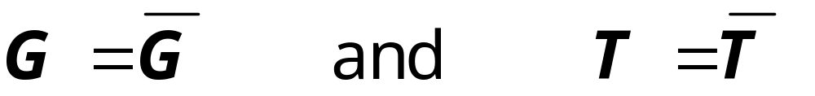
政府支出 G
G 包括政府部门在产品和服务上的支出。
G 不包括 转移支付。
假设政府支出和总税收外生给定，即：
slide <number>
Notes:
It might be useful to remind students of the meaning of the terms “exogenous” and “transfer payments.”

Slide 30
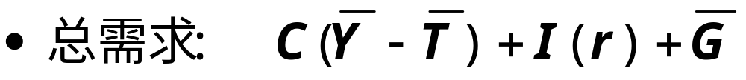
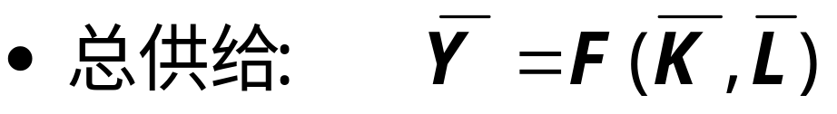
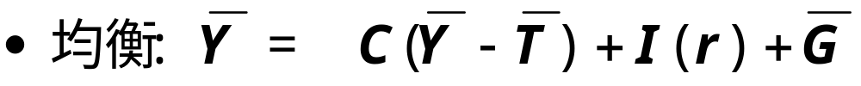
四、市场均衡
实际利率将调整至供求相等点。
slide <number>
Notes:
Note the only variable in the equilibrium condition that doesn’t have a “bar” over it is the real interest rate.
When the full slide is showing, before you advance to the next on, you might want to note that the interest rate is important in financial markets as well, so we will next develop a simple model of the financial system.

Slide 31
另一个视角：
可贷资金市场
简单的金融体系供求模型
只有一种资产： “可贷资金”
  对资金的需求：投资
  对资金的供给：储蓄
  资金的“价格”: 实际利率
slide <number>

Slide 32
对资金的需求：投资
对可贷资金的需求：
  来自投资:
  厂商借贷资金用以支付设备、建筑等
  家庭借贷用以购买房产等。
  反向取决于r，后者即可贷资金的“价格” (借贷成本)。
slide <number>

Slide 33
可贷资金需求曲线
r
投资曲线同时也是可贷资金的需求曲线。
I (r )
I
slide <number>

Slide 34
资金的供给：储蓄
资金的供给来自储蓄:
  家庭 将他们的储蓄存入银行、购买债券或其它资产。这些资金成为厂商可借贷的来源，以用于投资支出。
  政府 也有助于形成储蓄，如果它没有花费完收到的税收。
slide <number>

Slide 35
储蓄的类型
私人储蓄= (Y –T ) – C
公共储蓄= T – G
国家储蓄 S
  = 私人储蓄 + 公共储蓄
  = (Y –T ) – C + T – G
  = Y – C – G
slide <number>
Notes:
After showing definition of private saving,
- give the interpretation of the equation: private saving is disposable income minus consumption spending
- explain why private saving is part of the supply of loanable funds:
Suppose a person earns $50,000/year, pays $10,000 in taxes, and spends $35,000 on goods and services. There’s $5000 remaining. What happens to that $5000? The person might use it to buy stocks or bonds, or she might put it in her savings account or money market deposit account. In all of these cases, this $5000 becomes part of the supply of loanable funds in the financial system.
After displaying public saving, explain the equation’s interpretation: public saving is tax revenue minus government spending.
Notice the analogy to private saving-- both concepts represent income less spending: for the private household, income is (Y-T) and spending is C. For the government, income is T and spending is G.

Slide 36
预算盈余与赤字
当 T > G ,
预算盈余= (T – G ) = 公共储蓄
当 T < G ,
预算赤字= (G –T )=公共储蓄为负值
当 T = G ,
预算平衡，公共储蓄= 0.
slide <number>

Slide 37
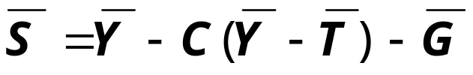
可贷资金供给曲线
实际利率 r
国家储蓄不取决于利率r，所以其供给曲线是垂直的。
储蓄S 或投资I
slide <number>

Slide 38
可贷资金市场的均衡
实际利率 r
均衡的实际利率
I (r )
均衡的投资水平
储蓄S 或投资I
slide <number>

Slide 39

利率 r的特殊作用
利率 r 作出调整以使产品市场和可贷资金市场同时达到均衡：
如果可贷资金市场处于均衡状态，那么
Y – C – G = I
两边加上 (C +G ) ，得到
Y = C + I + G (产品市场的均衡)
因此，
可贷资金市场的均衡
产品市场的均衡
slide <number>
Notes:
This slide establishes that we can use the loanable funds supply/demand diagram to see how the interest rate that clears the goods market is determined.
Explain that the symbol ⇔ means each one implies the other. The thing on the left implies the thing on the right, and vice versa.
More short-hand: “eq’m” is short for “equilibrium” and “LF” for “loanable funds.”

Slide 40

投资需求的增加
r
投资意愿的增加…
…提高了利率.
r₂
r₁
但是均衡的投资水平并没有增加，因为可贷资金的供给固定。
I₂
I₁
S, I
slide <number>

Slide 41
储蓄和利率
为什么储蓄s 依赖于利率r ?
如果投资需求增加，结果会有什么不同？
  利率 r 会大幅增加吗？
  均衡的投资数值会发生变化吗？
slide <number>

Slide 42
当储蓄依赖于利率
实际利率
r
S
(
r
)
1. 投资需求增加
提高了利率.
B
2. .
A
I
2
. 并使得均衡的利率和投资水平提高
3. .
.
I
1
储蓄S 或投资I
slide <number>
Notes:
This is Figure 3-11 from page 65 of the text. See accompanying discussion.

Slide 43


财政政策分析
1. 赤字增加降低了储蓄…
r
r₂
2. …导致利率增加…
r₁
3. …降低投资水平。
I (r )
I₂
I₁
S, I
slide <number>

Slide 44
本章小结
总产出取决于
  该经济体拥有多少资本和劳动
  技术水平
竞争性的厂商在诸要素的边际产量等于要素的实际价格处实现均衡。
如果生产函数具有不变规模收益，那么劳动收入加资本收入将等于总收入 （总产出）。
slide <number>

Slide 45
本章小结
总产出被用于：
  消费
  (消费取决于可支配收入)
  投资
  (投资取决于实际利率)
  政府支出
  (政府支出是外生变量)
实际利率水平将调整至下列要素的供给和需求达到均衡为止：
  产品和服务
  可贷资金
slide <number>

Slide 46
本章小结
政府赤字的增加将提高利率并降低投资。
投资需求的增加将导致利率上升，但如果可贷资金的供给不变，那么投资需求的增加并不会影响均衡的投资水平。
slide <number>

Slide 47
谢谢！

